Slide 1


Sugeng Wahyudi
25th July 2022

Slide 2

Outline
Executive Summary
Introduction
Methodology
Results
Conclusion
Appendix

Slide 3
Executive Summary
After data have been wrangled and make some explanatory analysis, we can make a machine learning model to predict spaceX success landing with accuracy, and algorithm as follow
Method/Algorithm | Accuracy
Logistics Regression | : 1
Support Vector Machine | : 0.9444444444444444
Decision tree | : 0.9444444444444444
K nearest neighbors | : 1

Slide 4
Introduction
Space-related industries are so expensive because the cost of the rockets. Indeed, SpaceX can make the cost cheaper than competitors because SpaceX can reuse its first stage(rocket).
So, to push the cost of operation, it is very important that we analyze the spaceX launch data and get insights for optimum spaceX launch.

Slide 5

Section 1

Slide 6
Methodology
Executive Summary
Data collection methodology:
Data collected using two methods that is using API and Web Scraping
Perform data wrangling
Data cleaned, and processed to output outcome label that classifies the first stage land successfully or not
Perform exploratory data analysis (EDA) using visualization and SQL
Perform interactive visual analytics using Folium and Plotly Dash
Perform predictive analysis using classification models
How to build, tune, evaluate classification models

Slide 7
Data Collection
Data obtained using two methods that are using API from spacexdata website and Webscraping from wikipages as follow:
API | Webscraping
- Using request to get data from spacexAPI | - Using request to get data from wikipedia
- Decode json response and turn to dataframe using .json_normalize() | - Parse the response using BeautifulSoup to make easy to understand html and to navigate to the table data
- Wrangled data to make the dataframe clean as expected | - Extract data from html table to pandas dataframe using BeautifullSoup

Slide 8
Data Collection – SpaceX API
We used request to get data from the spaceX API to collect data that contain rockets, launchpads, payloads, cores.
Data then wrangled to make clean pandas dataframe
Here is the notebook I used to get data from SpaceX API https://github.com/Gengsu07/LEARNING_REPO/blob/main/jupyter-labs-spacex-data-collection-api.ipynb
SpaceX API api.spacexdata.com/v4
rockets
launchpads
payloads
cores

Slide 9
Data Collection - Scraping
Data is fetched from Wikipedia using request and then parse with beautifulsoup to make HTML response more readable.
Bs4 is also used to navigate to the table needed, then the data extracted to pandas dataframe
Here is the notebook https://github.com/Gengsu07/LEARNING_REPO/blob/main/jupyter-labs-webscraping.ipynb
Wikipedia
Request, BeautifulSoup
Pandas Dataframe

Slide 10
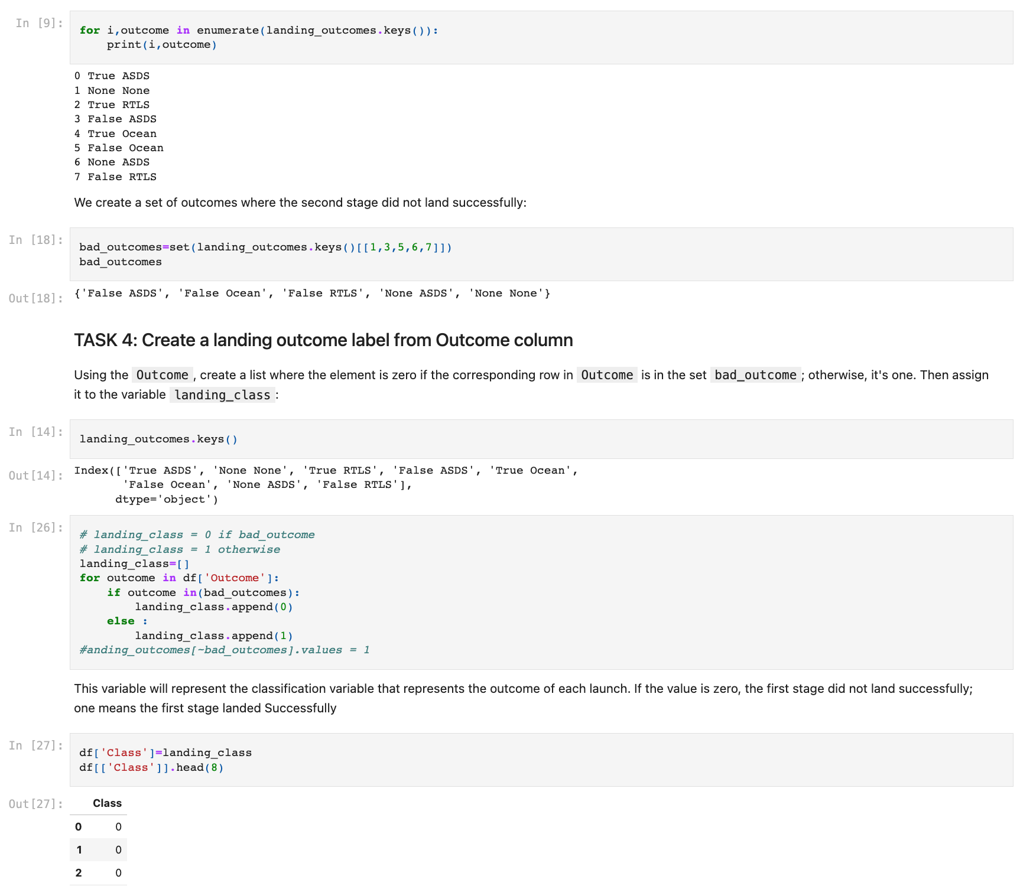
Data Wrangling
Before wrangled, we make basic EDA to understand the data to check null, missing value, and value_counts
Based on outcome column, make labels column ‘Class’ to classify the outcome to 0 if failed and 1 if success
Here is complete jupyter notebook code I used:https://github.com/Gengsu07/LEARNING_REPO/blob/main/labs-jupyter-spacex-Data%20wrangling.ipynb

Slide 11
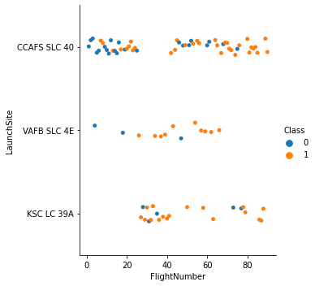
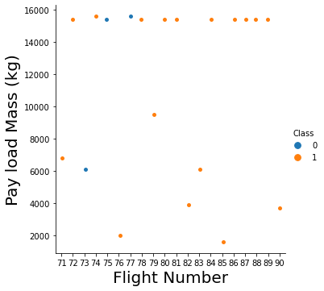
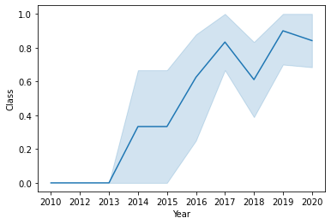
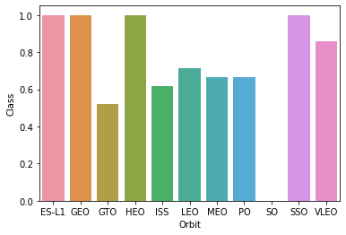
EDA with Data Visualization
Categorical Plot
Using catplot to inspect relationship between flight number and payload mass, flight number and launch site affect to the outcome
Scatterplot
Using scatterplot to inspect relationship payload mass and launch site, flight number and orbit type affect to the outcome
Bar Chart
Using bar chart to view success rate across orbit type
Line Chart
Using lineplot to visualize yearly trend average success rate
Here is the notebook
https://github.com/Gengsu07/LEARNING_REPO/blob/main/jupyter-labs-eda-dataviz.ipynb

Slide 12
EDA with SQL
Data loaded to IBM Db2 database instance on IBM cloud, so we can query and analyze the data from Jupyter Notebook using IBM Db2 connector. Then we analyze the data as follow:
The names of unique SpaceX mission launch site
5 launch site names that begin with ‘CCA’
Total payload mass carried by booster NASA CRS
Average payload mass carried by booster F9 v1.1
List date when first successful landing outcome in ground pad was achieved
List names of boosters that have success landing in drone ship have payload mass greater than 4000 but less than 6000
List the total number of successful and failure mission outcomes
List the names of the booster_versions which have carried the maximum payload mass
List the failed landing_outcomes in drone ship, their booster versions, and launch site names for in year 2015
Rank the count of landing outcome between 2010-06-04 and 2017-03-20
Here is the notebook https://github.com/Gengsu07/LEARNING_REPO/blob/main/EDA%20with%20SQL.ipynb

Slide 13
Build an Interactive Map with Folium
We marked all launch sites with the launch site name, circle, and marker to show the launch site
For easy map interpretation, map object colored with red for failure(0) and green for succeed(1) to indicate the landing outcome of the site
Calculate distance between site and its proximity to answer some questions as follow:
How far launch site from railways, highways, coastline
Do launch sites keep certain distance from cities?
Here is my notebook https://github.com/Gengsu07/LEARNING_REPO/blob/main/Folium_Jupyter_launch_site_location.ipynb

Slide 14
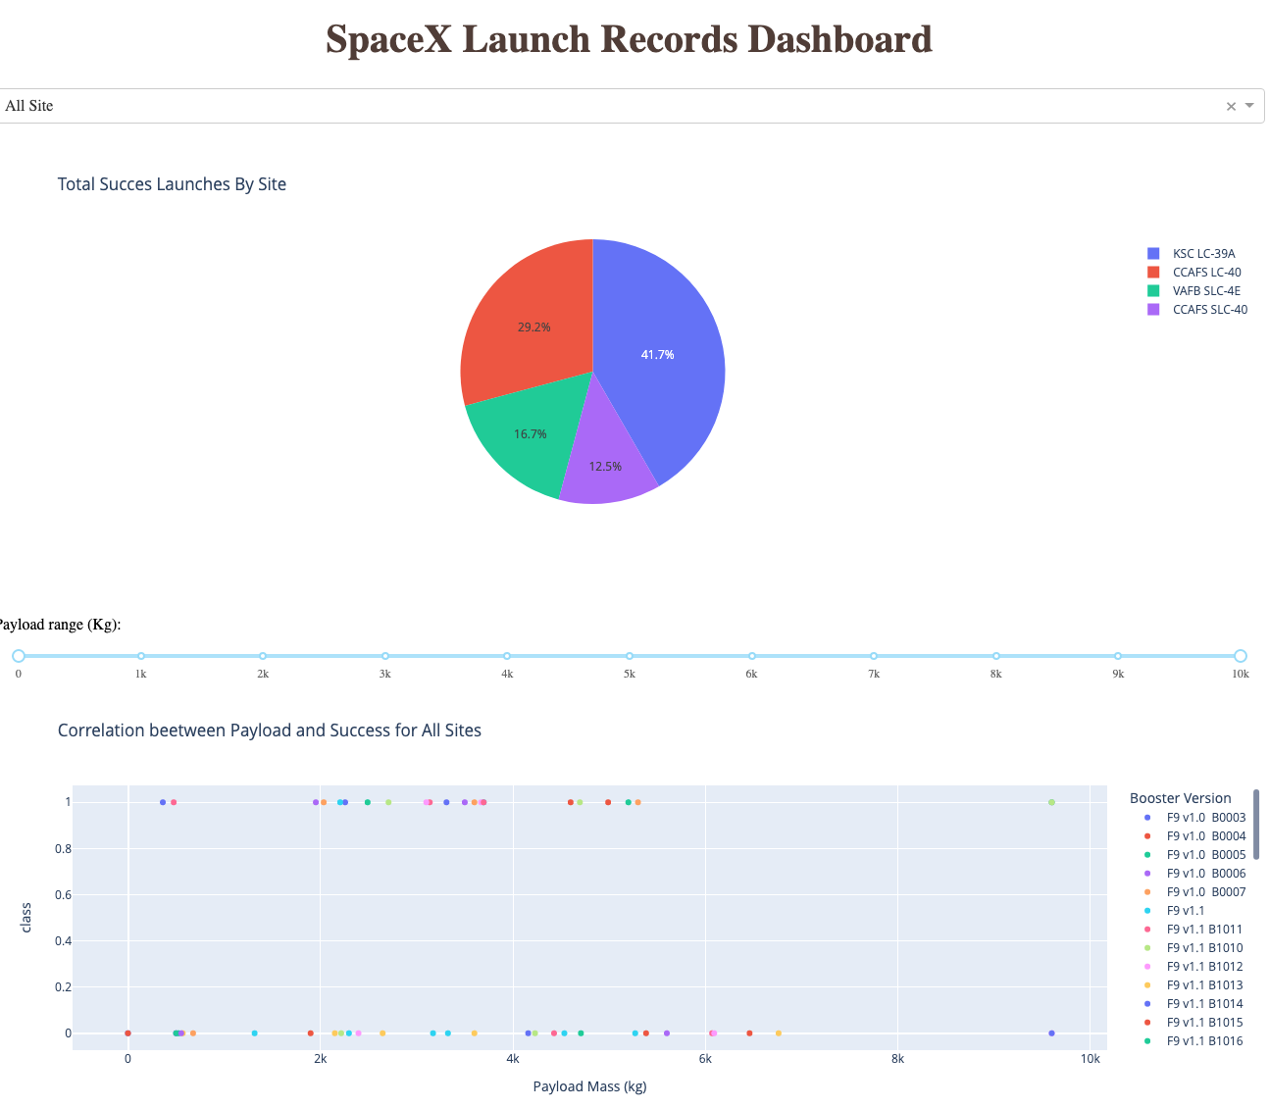
Build a Dashboard with Plotly Dash
To see relationship between launch sites, payload mass and launch outcome interactively, we use pie chart and scatter plot
To inspect interaction between variables, we use dropdown to choose launch sites and range slider to set the payload mass
We add the plots and interactions to see interaction between different launch site and payload mass that can affect the launch outcome
Here my plotly dash app python code https://github.com/Gengsu07/LEARNING_REPO/blob/main/spacex_dash_app.py

Slide 15
Predictive Analysis (Classification)
We loaded data to pandas dataframe, then transform class label that are categorical to numpy array
Features or X standardized using preprocessing standardscaler from sklearn
Dataset then splitted to train and test data using train test split from sklearn
Model trained using Decision Tree algorithm and using GridSearchCV to find the best parameters combination that achieve best accuracy.
Here is my notebook https://github.com/Gengsu07/LEARNING_REPO/blob/main/SpaceX_Machine%20Learning%20Prediction_Part_5.ipynb

Slide 16
Results
Exploratory data analysis results
Interactive analytics demo in screenshots
Predictive analysis results

Slide 17

Section 2

Slide 18
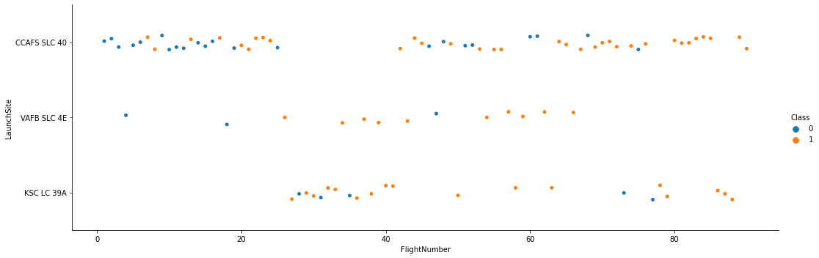
Flight Number vs. Launch Site
As we see, greater or recent flight numbers have more success than earlier flights.
Besides, we can rank the amount of flights at each launch site descending from CCAFS SLC 40, KSC LC 39A, and VAFB SLC 4E

Slide 19
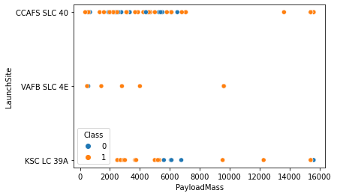
Payload vs. Launch Site
VAFB SLC 4E only used to small-sized payloads likely less than 10.000 Kg.
It seems that the more payload mass have more success landing outcome, especially for VAFB SLC 4E

Slide 20
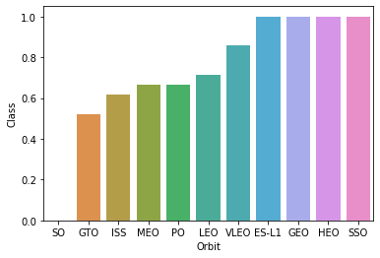
Success Rate vs. Orbit Type
Based on orbit type, we can obtain rank of success rate each orbit type ascending from SO to SSO

Slide 21
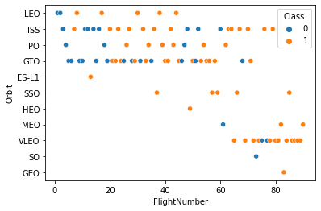
Flight Number vs. Orbit Type
In the early flights number about less than 40 the flights target LEO, ISS, PO and GTO orbit type, ESL-L1 and SSO just1 flight
LEO orbit type only used less than 50 flight number
Other orbit type become more targeted on recent flight numbers especially on VLEO orbit

Slide 22
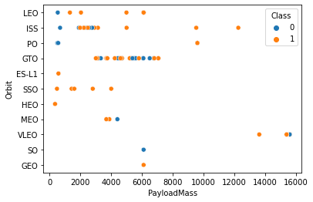
Payload vs. Orbit Type
SSO is consistently successful but only used to small-sized payload
GTO used for payload that have mass in range 3000 kg to 8000 kg
ES-L1, HEO, and GTO only have 1 flight and its succed, SO also have 1 flight but failed
LEO and ISS have more succed on hight payload mass

Slide 23
Launch Success Yearly Trend
Based on the plot, success rate trend increased yearly from 2013 to 2020

Slide 24
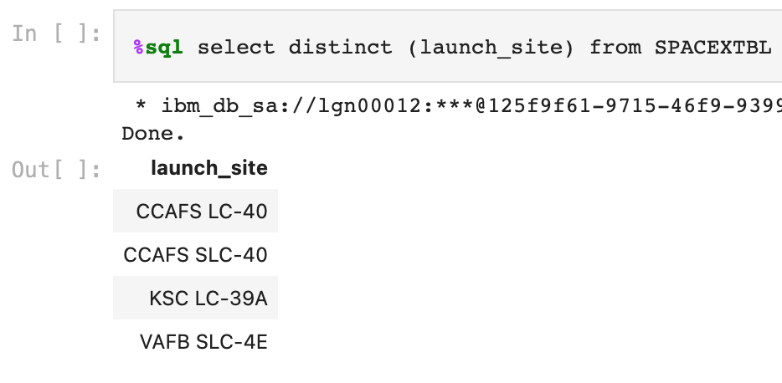
All Launch Site Names
To get unique launch site, we use distinct keyword to retrieve from SpaceX Data table

Slide 25
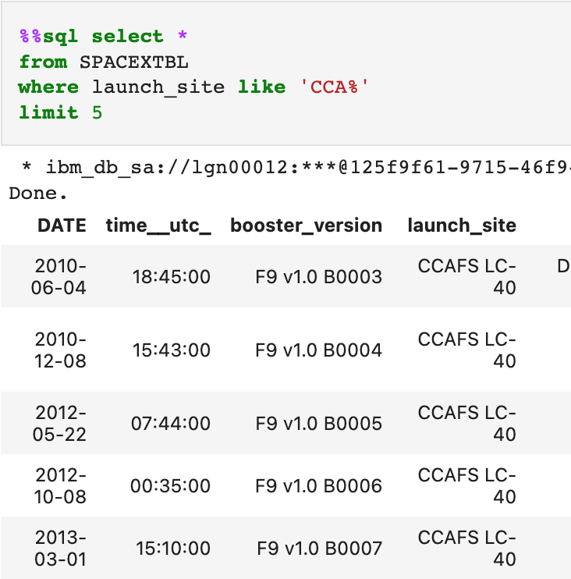
Launch Site Names Begin with 'CCA'
I’m using ‘like’ wildcard to get launch site that begins with ‘CCA’.
To restrict only 5 record, we use ‘limit’ keyword

Slide 26
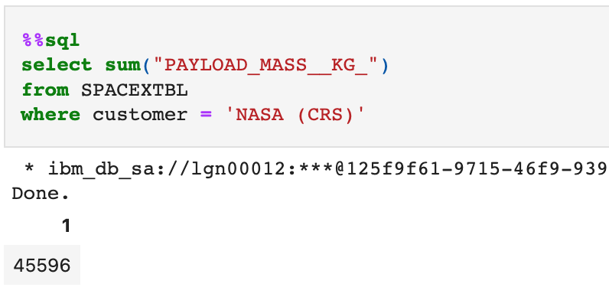
Total Payload Mass
To get total payload mass we using ‘sum’ keyword and ’where’ to filter customer

Slide 27
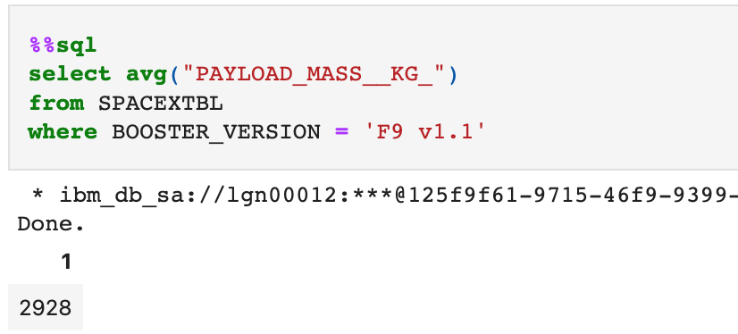
Average Payload Mass by F9 v1.1
We using ‘avg’ to calculate average payload mass and ‘where’ to filter the booster_version

Slide 28
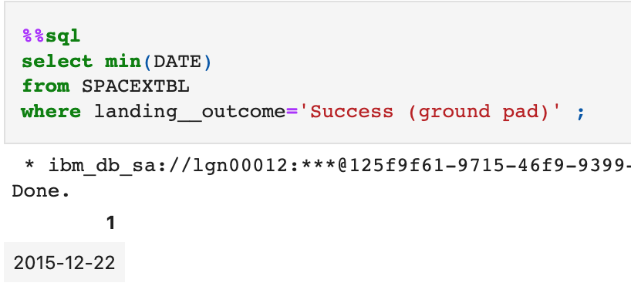
First Successful Ground Landing Date
We using ‘where’ to filter landing outcome , then add ‘min’ keyword to get the first date based the criteria

Slide 29
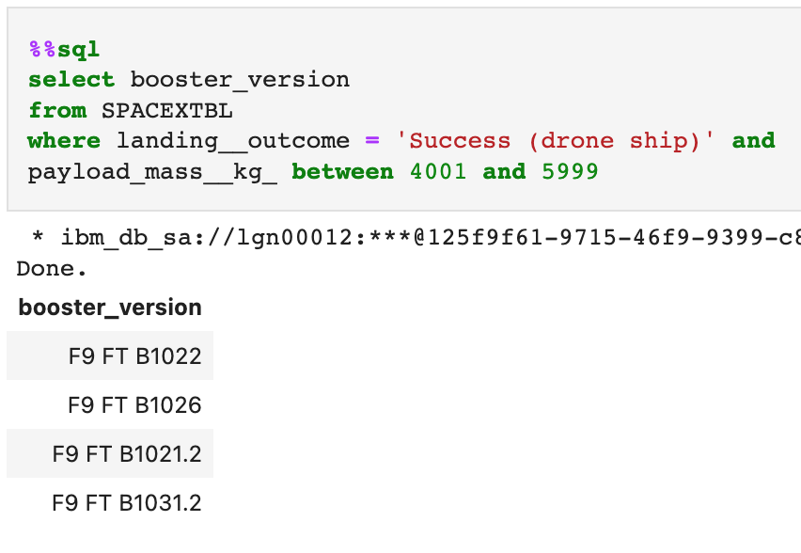
Successful Drone Ship Landing with Payload between 4000 and 6000
We using ‘where’ to filter landing outcome and using ‘between’ to slice payload mass in range 4001 to 5999

Slide 30
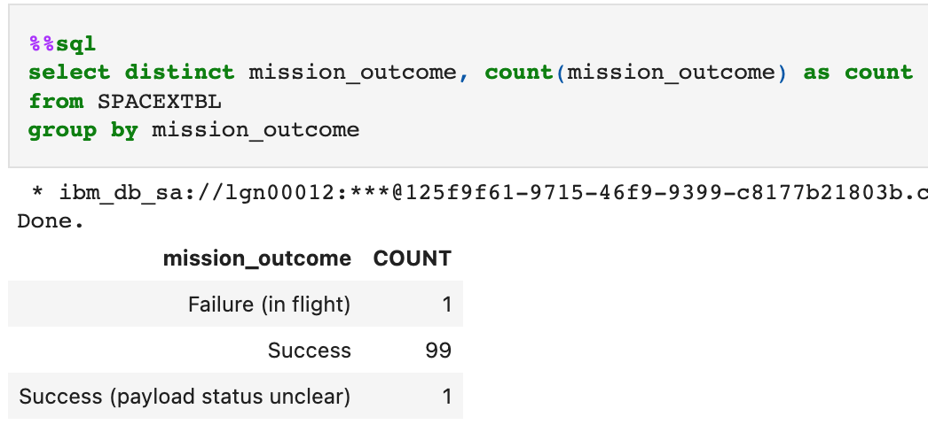
Total Number of Successful and Failure Mission Outcomes
First we retrieve distinct mission outcome that should contain success or failure.
Then we count the occurences of each mission outcome using group by

Slide 31
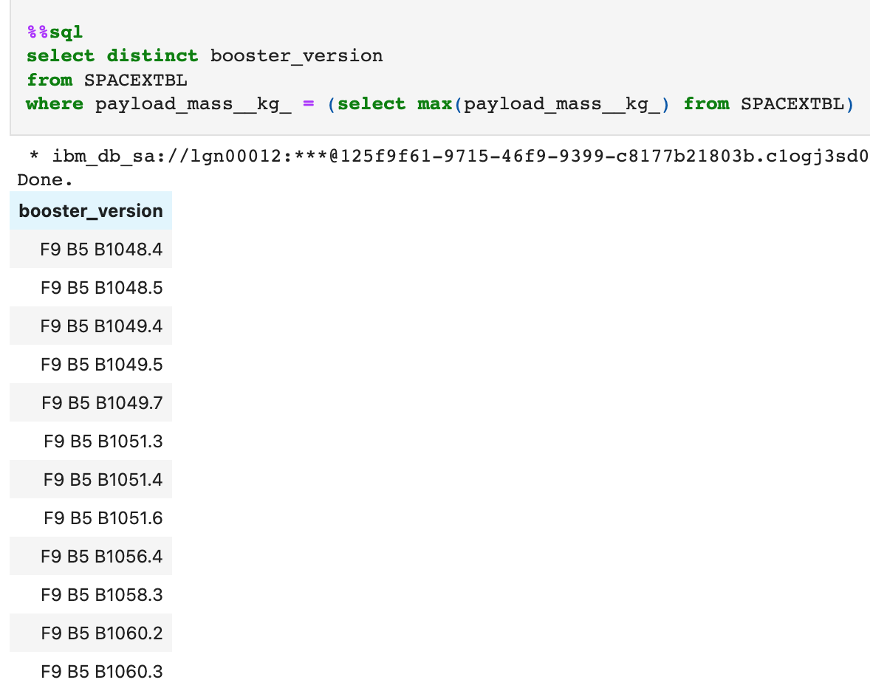
Boosters Carried Maximum Payload
We set ‘where’ condition using subquery to only return record that have maximal payload mass, after that we retrieve unique booster version using ‘distinct’ keyword

Slide 32
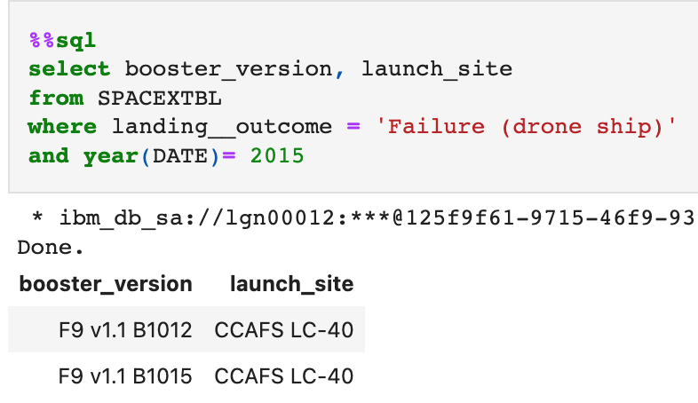
2015 Launch Records
We using ‘year’ to get the year of the flight to only in 2015 and filter the landing outcome to get onl ‘Failurre (drone ship)’

Slide 33
Rank Landing Outcomes Between 2010-06-04 and 2017-03-20
Rank the count of landing outcomes (such as Failure (drone ship) or Success (ground pad)) between the date 2010-06-04 and 2017-03-20, in descending order
Present your query result with a short explanation here

Slide 34

Section 3

Slide 35

SpaceX Launch Sites Map
All launch sites are near from coast and have proximity with the equator line

Slide 36

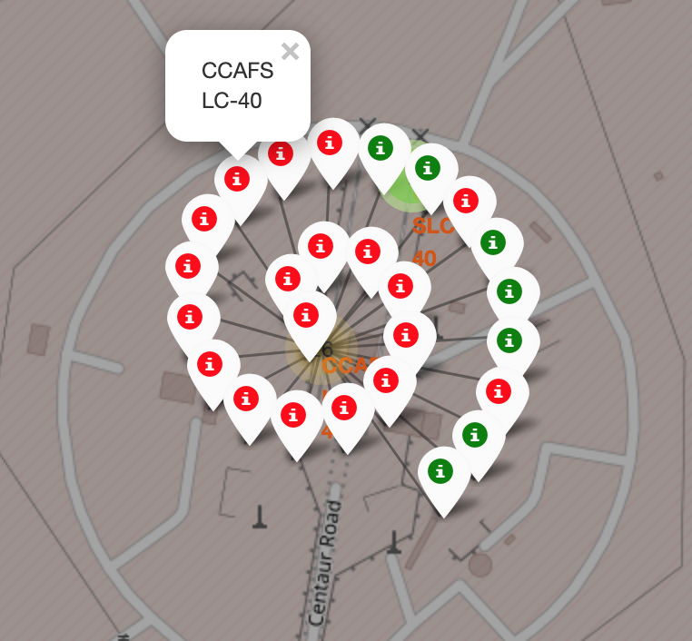
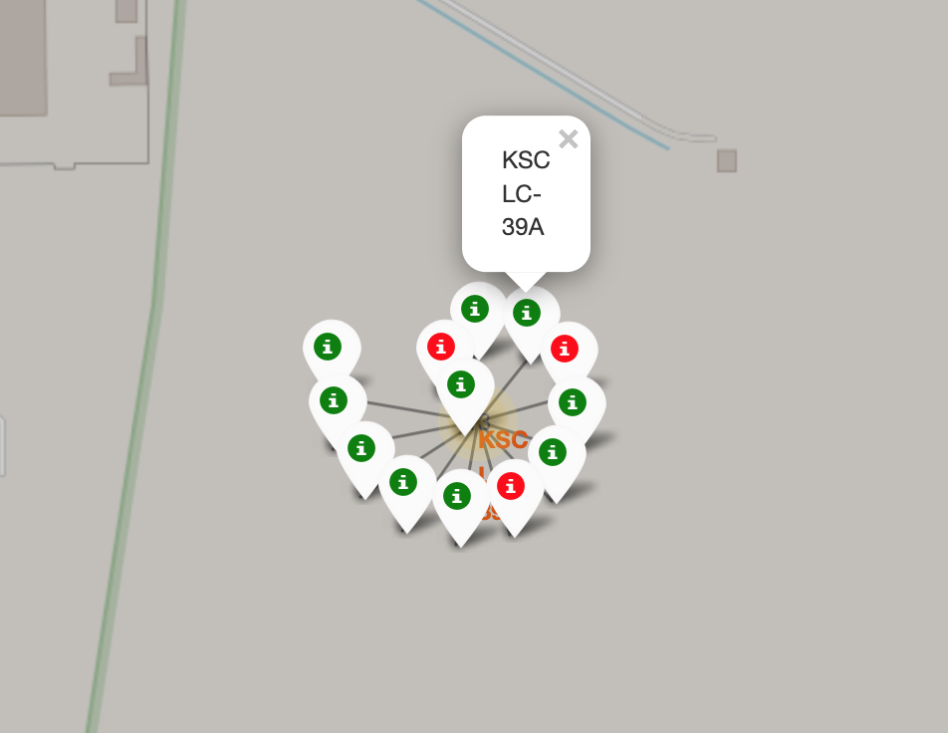
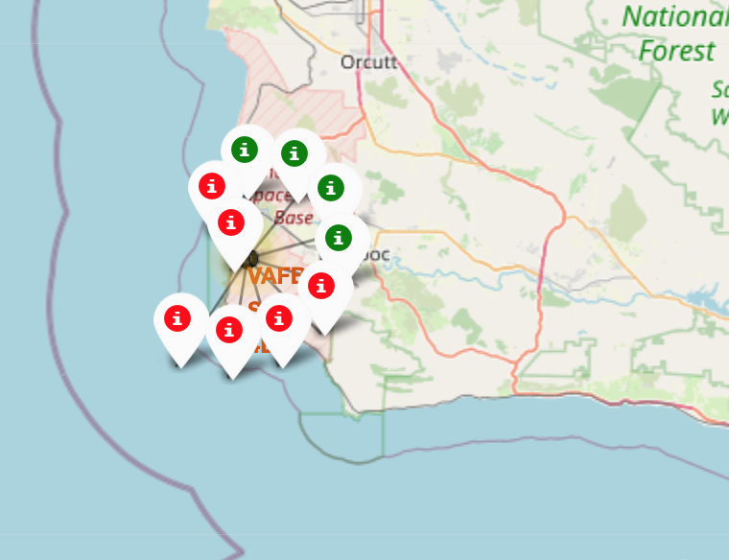
SpaceX Success Launch Map
Launch sites colored based on succeed landing outcome
Green for success and Red for failure

Slide 37
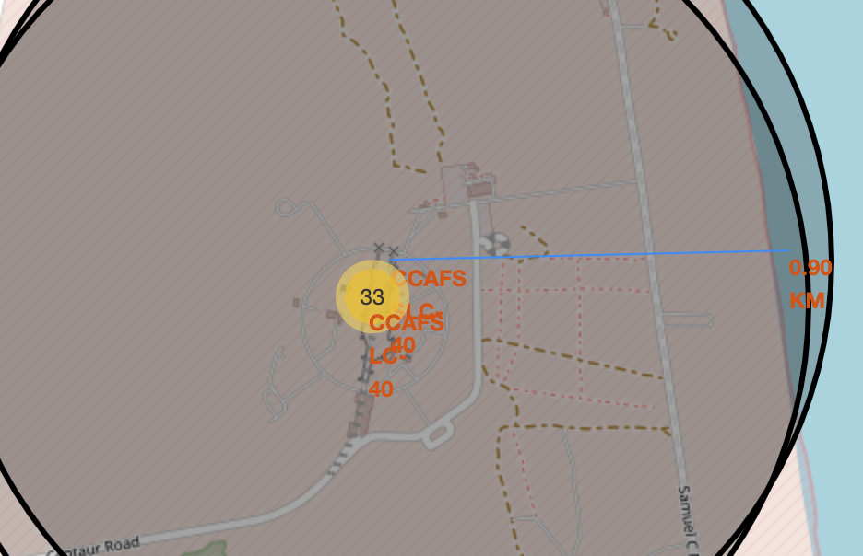
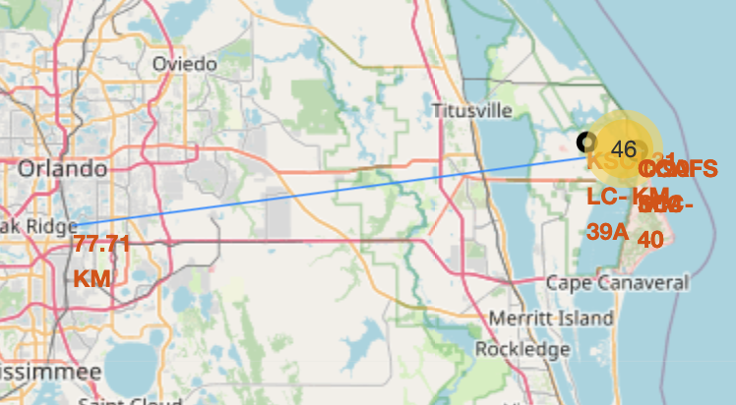
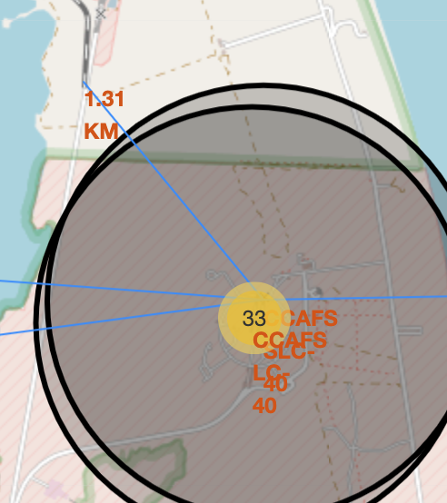
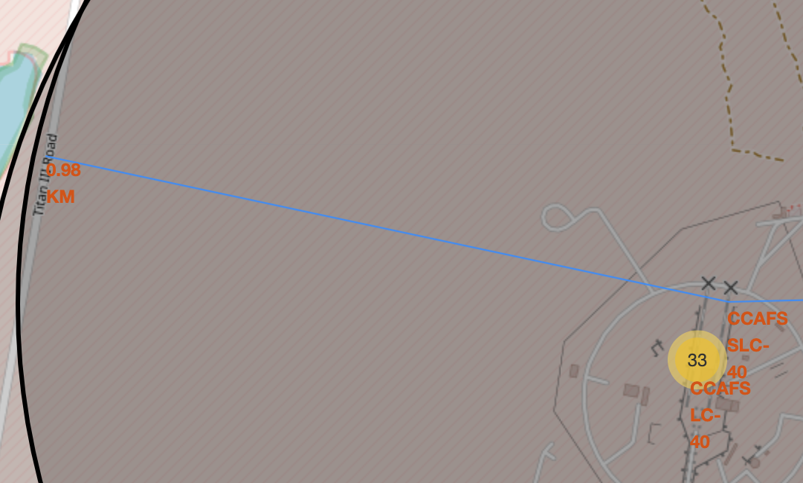
SpaceX Launch Site Proximity
Launch Site distance to city
Launch distance to coastline
Launch distance to railways
Launch site near from coast, road, and railways but far from cities
Launch distance to road
https://github.com/Gengsu07/LEARNING_REPO/blob/main/Folium_Jupyter_launch_site_location.ipynb

Slide 38

Section 4

Slide 39
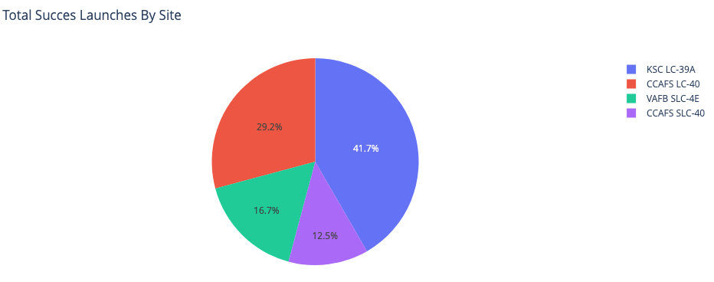
Success Rata Across Laucnh Site
Easily understand success rate SpaceX landing outcome across launch site.
KSC LC-39A has the biggest success rate

Slide 40
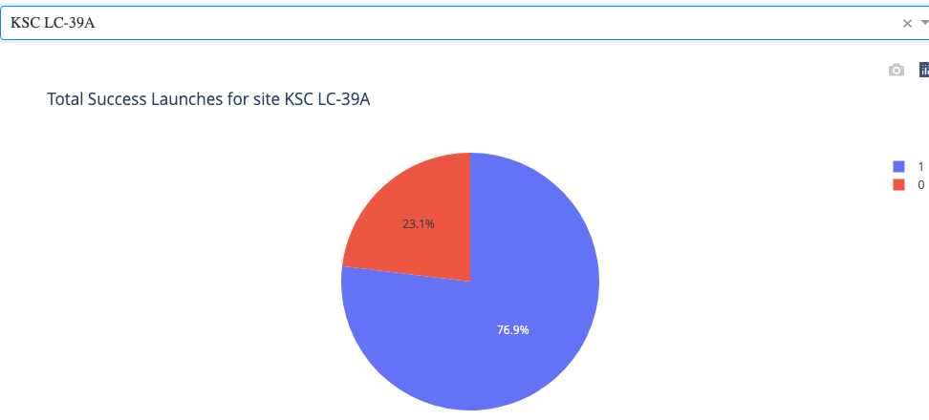
Drilldown Succes Rates each Launch Site
Drilldown to see landing outcome percentages in each launch site.
KSC LC-39A have 76,9% success landing and 23,1% failure

Slide 41
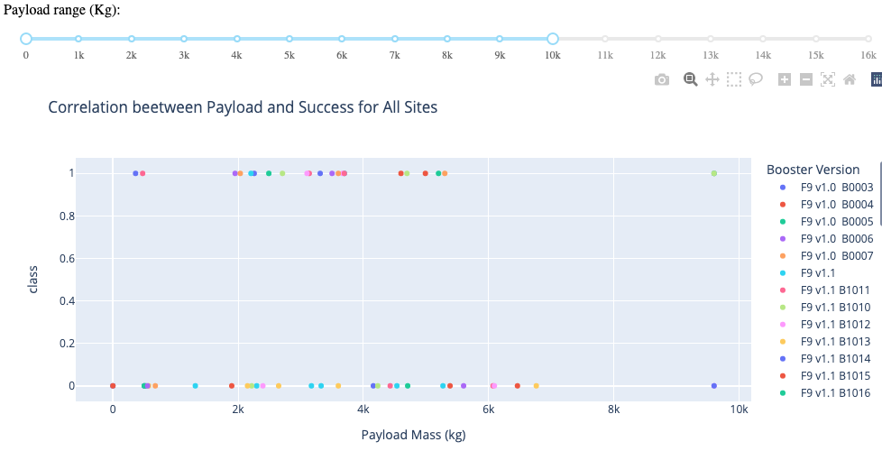
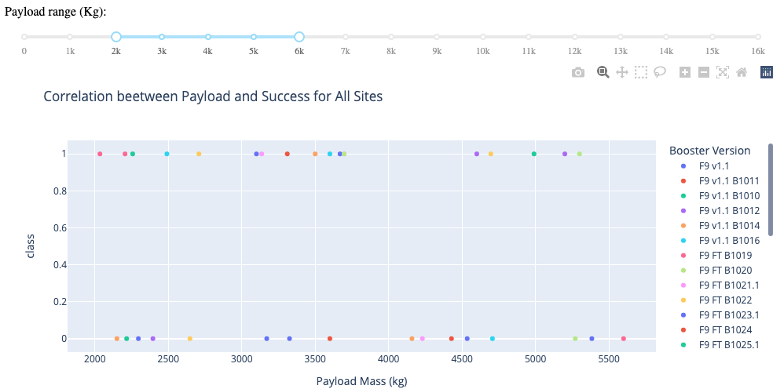
Payload Mass and Booster to Success
Insights relationship payload mass, booster version, and its effect on landing outcome easily found
Most of the successful booster have payload mass between 2.000Kg and 5.500 Kg

Slide 42

Section 5

Slide 43
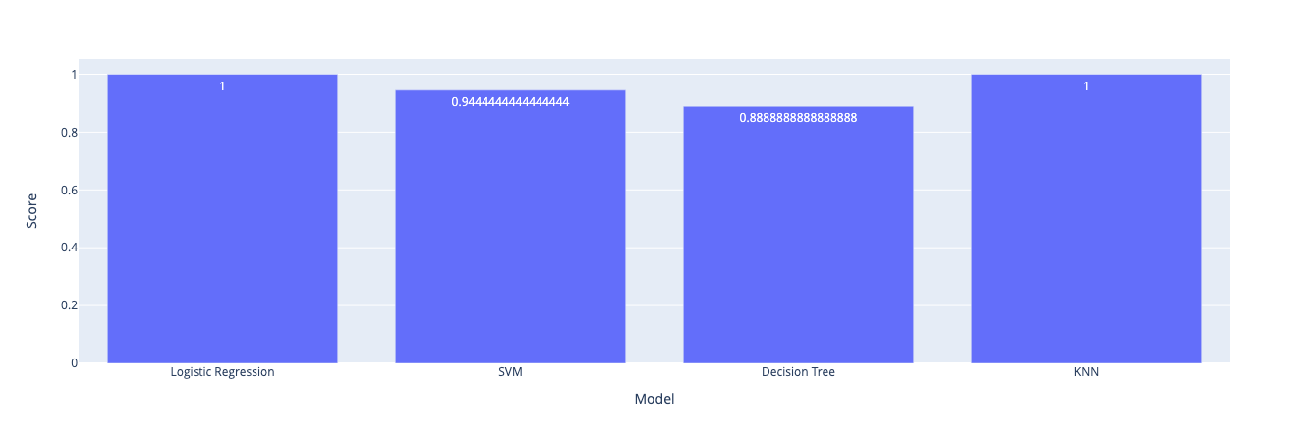
Classification Accuracy
Logistic Regression and KNN has the highest accuracy score

Slide 44
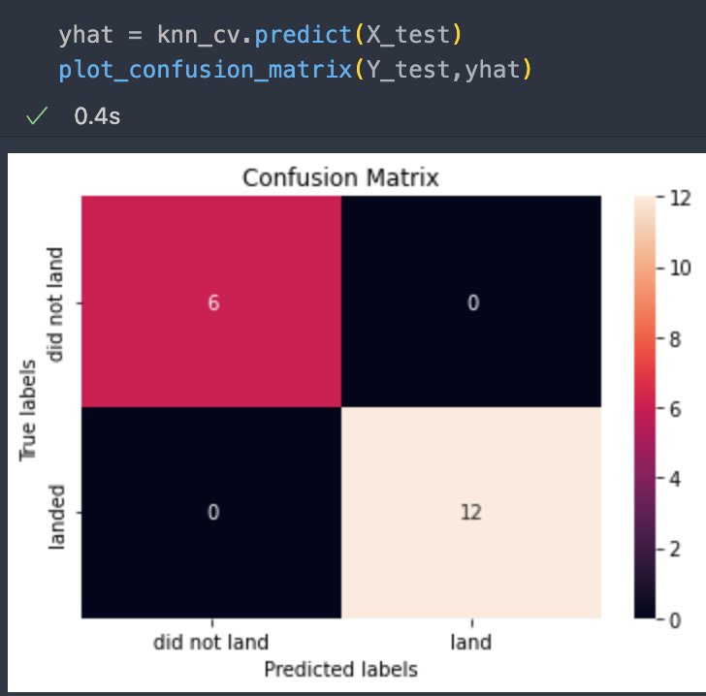
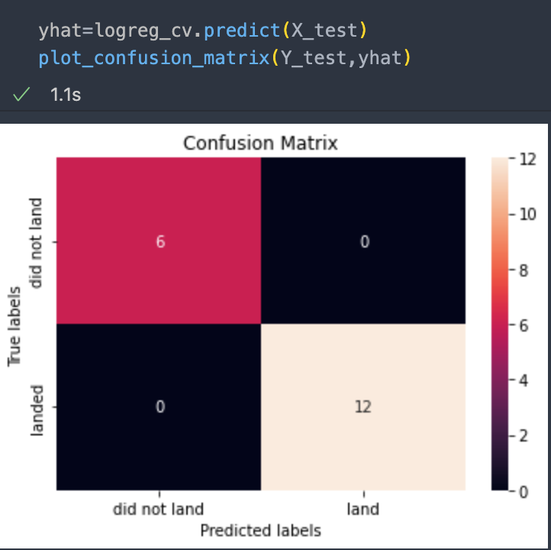
Confusion Matrix
KNN model perfectly predict true did not land 6 with 0 false, and predict 12 landed with zero false
Logistic Regression model perfectly predict true did not land 6 with 0 false, and predict 12 landed with zero false

Slide 45
Conclusions
KSC LC-39A have the highest success rate across launch sites
Payload mass between 2k Kg and 5.5k Kg seems have more succeed than others
ES-L1, GEO, HEO, and SSO orbit type tend to have high success landing outcome
Logistic Regression and KNN are suited model to predict the landing outcome
66,67% SpaceX Flights are Succeed
SpaceX can reuse their rockets about 66,67%
SpaceX rockets cost can be cheaper because 66,67% their first stage can be saved

Slide 46
Appendix
All the codes can be found in my github repositories here https://github.com/Gengsu07/LEARNING_REPO

Slide 47


